Slide 1
MORTGAGE CALCULATOR
Steven Wu
Daniel Le

Slide 2
Outline
Background
System Requirements
Technologies
Database Tables
Front-end Details
System Workflow
Demo

Slide 3
Background
Mortgage loan
“A mortgage loan, also referred to as a mortgage, is used by purchasers of real property to raise money to buy the property to be purchased or by existing property owners to raise funds for any purpose.” (Wikipedia)

Slide 4
Background
Mortgage Calculator
“A mortgage calculator is an automated tool that enables the user to quickly determine the financial implications of changes in one or more variables in a mortgage financing arrangement.” (Wikipedia)

Slide 5
Mortgage Types
Fixed-rate mortgage
30 years
20 years
15 years
Adjustable-rate mortgage(ARM)
5/1 ARM
7/1 ARM
10/1 ARM

Slide 6

Basic Formula Applied In The Project
Monthly payment formula
,where c: monthly payment
r: monthly interest rate
N: number of months
P: loan’s principal

Slide 7
System Requirements
Information gathered from users:
Principal
Abstract Payment Plan
Location
Information provided to users:
General Information
Payment Plan Details
Charts

Slide 8
Technologies
HTML5/CSS3/Bootstrap
JavaScript/jQuery/AngularJS/AJAX
Database: Oracle 10g
Core Java
Spring MVC/Spring Security/Spring IoC/Spring Dao Support/Spring Cache
Hibernate
REST
Java Mail

Slide 9
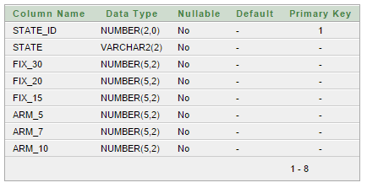
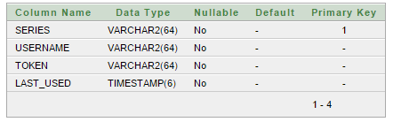
Database Tables
Interest table
Persistent_logins table

Slide 10
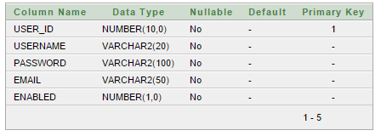
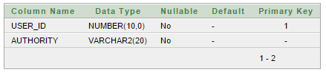
Database Tables
Users table
User_roles table

Slide 11
Front-end Details
Single Page Application
Validations
Data Bindings
Web Service

Slide 12
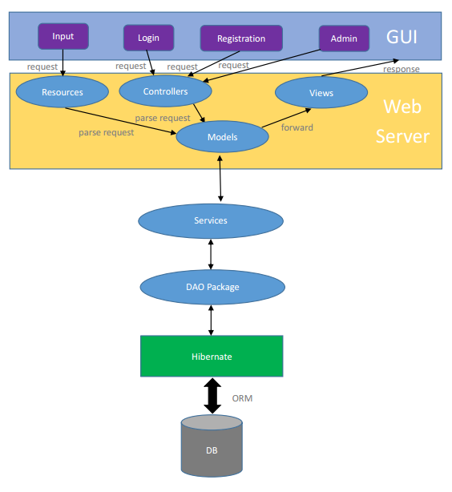
System Workflow

Slide 13
DEMO

Slide 14
Thank you for listening!

